Slide 1
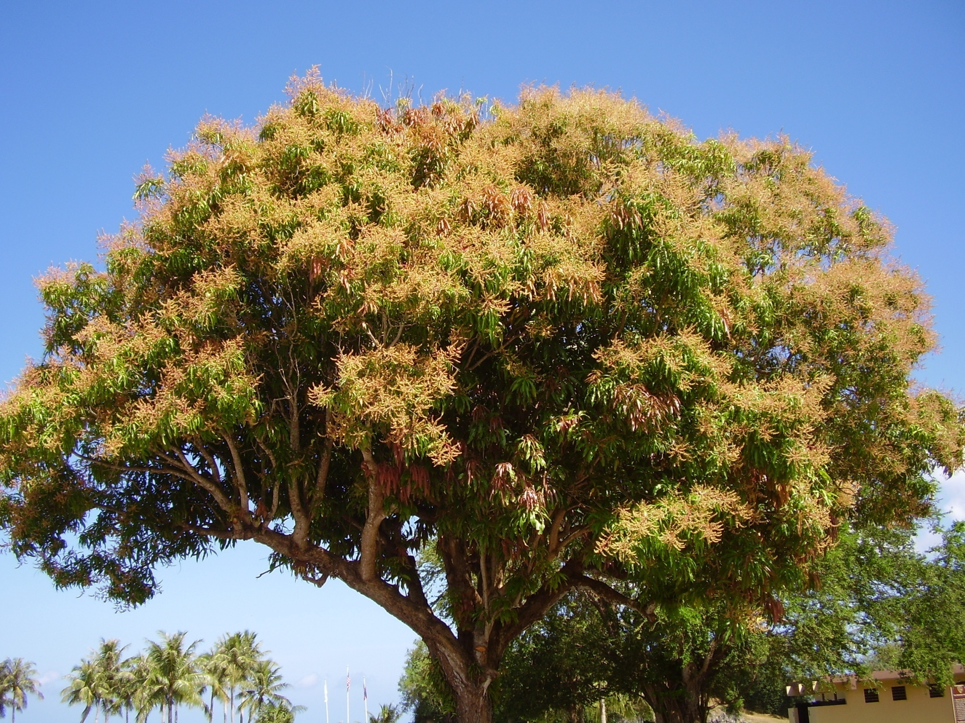
October 3, 2017

Slide 2
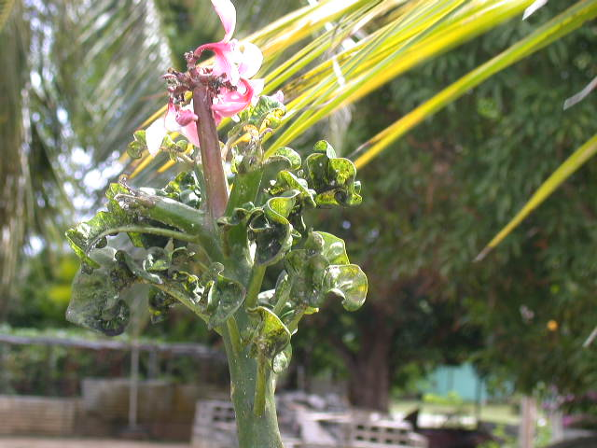
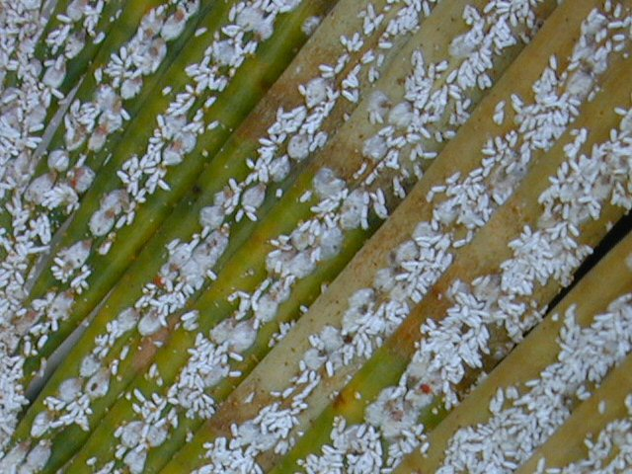
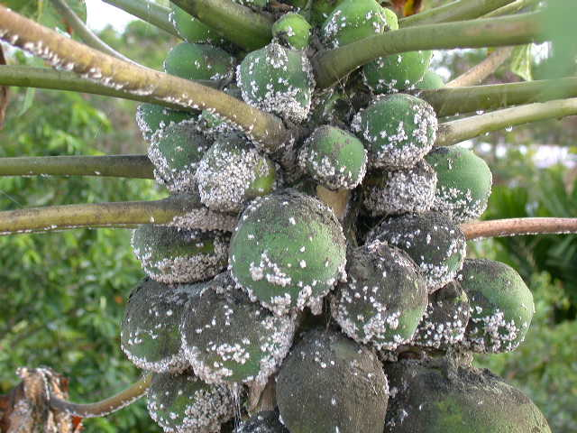
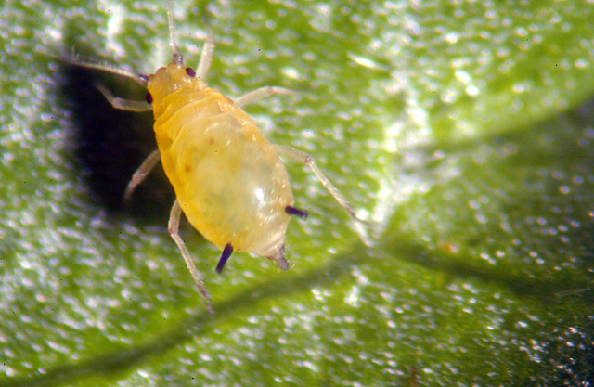
Insects

Slide 3
Number of Insect Species
World
Micronesia
1 million species of insects have been described
Maybe 30 million species in total
“Only” about 10,000 species of insects in Micronesia
About 45% of these are endemic (evolved here)

Slide 4
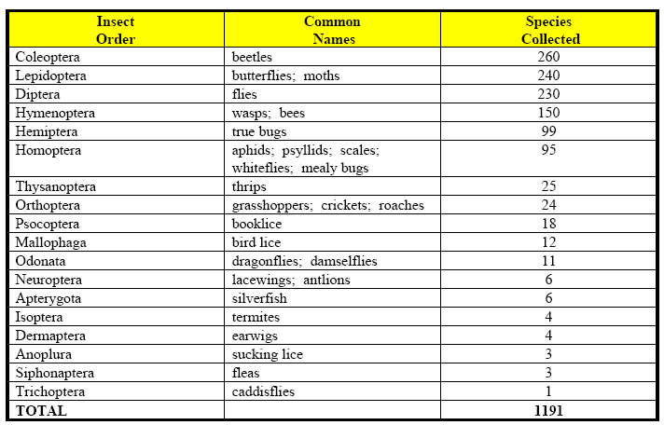
Number of Insect Species Collected on Guam (Gressitt 1954)

Slide 5
Are all insects pests?
Globally there are about 3,500 species of insect pests (0.35% of total species)
In Micronesia there are about 400 species of insect pests (4% of total species)
Many non-pest insects are actually beneficial: bees pollinate crops, insect predators and parasites control populations of pest insects and weeds, and many species provide ecosystem services by helping to recycle dead plants and animals

Slide 6
Number of new records of insect pest species in Guam between 1945 and 1990 (Schreiner 1991).
Order
New Records
Homoptera
12 (48%)
Coleoptera
5
Lepidoptera
3
Orthoptera
1
Thysanoptera
1
Diptera
1
Hymenoptera
1
Acari
1

Slide 7
Invasive Insects on Guam since WWII
Banana leaf roller Erionota thrax 1957
Philippine lady beetle Epilachna philippinensis 1948
Citrus swallowtail Papilio polytus 1945
Bean pod borer Ophiomyia phaseoli 1951
Cucumber beetle Aulacophora similis 1951
Leaf miner Liriomyza sativae 1960
Mosquito Anopheles subpictus 1950
Chinese rose beetle Adoretus sinicus 1951
Sweetpotato bug Physomerus grossipes 1964
Flame tree looper Pericyma cruegeri 1971
Flat beetle Brontispa palauensis 1973
Mud wasp Delta pyriforme 1972
Flower beetle Protaetia orientalis 1972
Soursop beetle Kallitaxilia crini 1970
Bagworm Brachycittarus griseus 1976
Scarab beetle Popillia lewisi 1985

Slide 8
New Island Records for Guam 2004
Coleoptera
Midway emerald beetle, Protaetia pryeri (Scarabaeidae)
Calamansi weevil, possibly Myllocerus sp. (Curculionidae)
Scarab beetle, Popillia sp. nr. taiwana (Scarabaeidae)
Homoptera
Cycad scale, Aulacaspis yasumatsui (Diaspididae)
False oleander scale, Pseudaulacaspis cockerelli (Diaspididae)
Cardin's whitefly, Metaleurodes cardini (Aleyrodidae)
Coconut mealybug, Nipaecoccus nipae (Pseudococcidae)
Greenhouse ensign coccid, Orthezia insignis (Orthezidae)

Slide 9
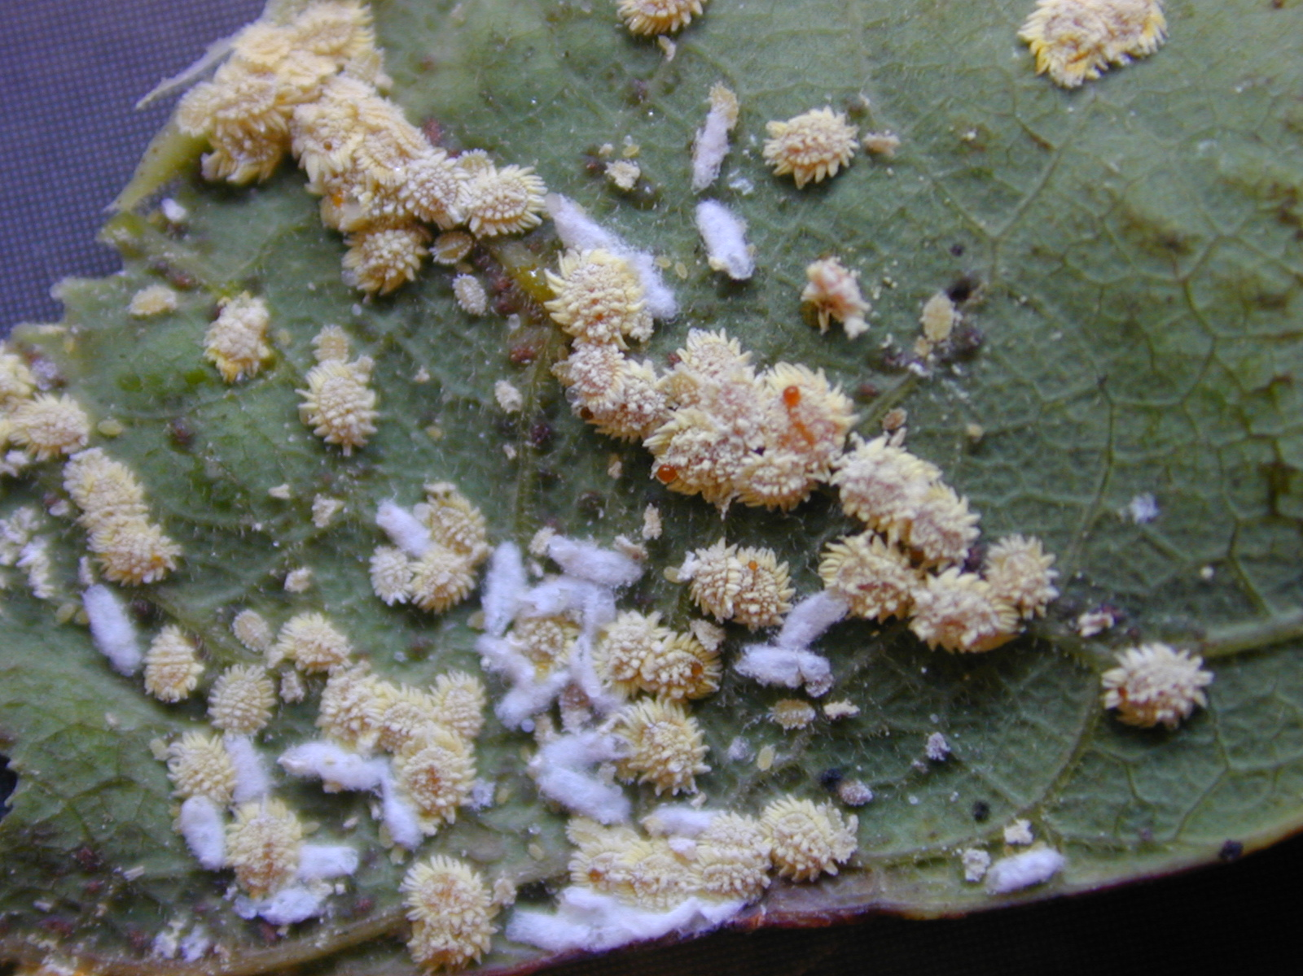
Coconut mealybug, Nipaecoccus nipae

Slide 10
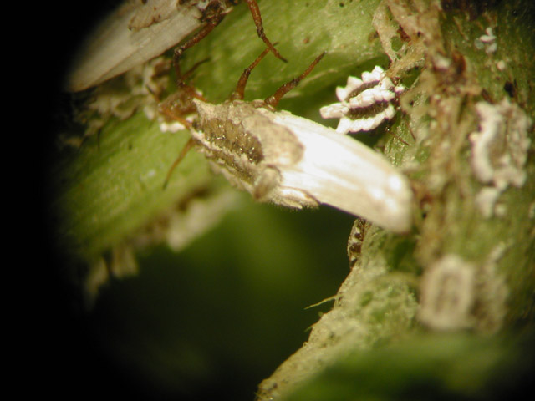
Greenhouse ensign coccid, Orthezia insignis

Slide 11
Aphids
18 different species on Guam

Slide 12
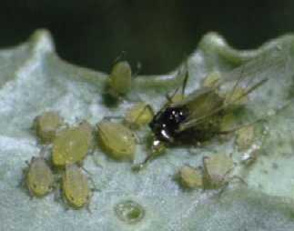
Aphids
winged
aphid

Slide 13
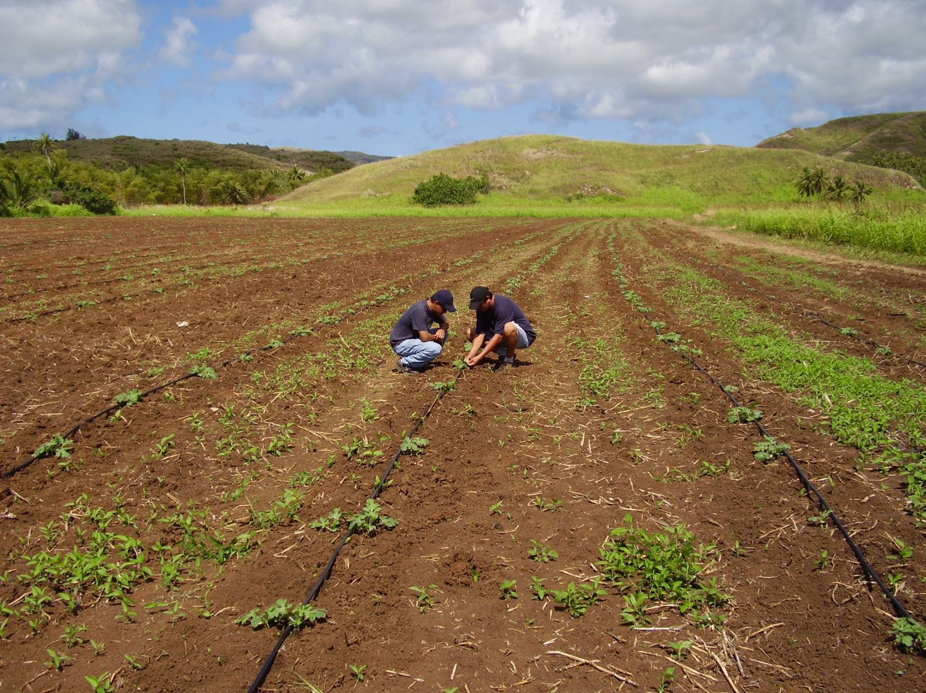

Slide 14
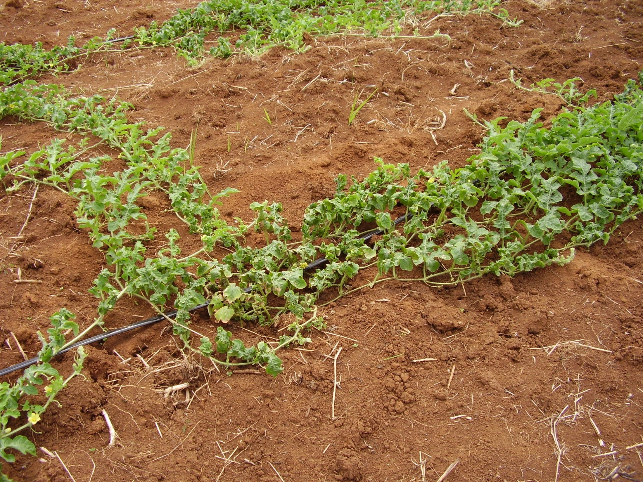

Slide 15
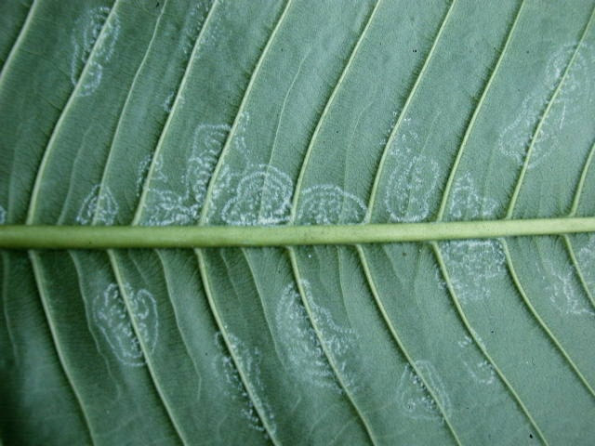
Spiraling White Fly

Slide 16
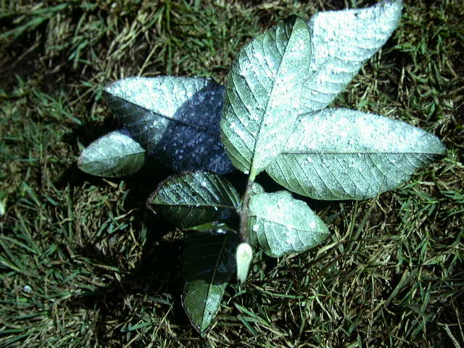
Spiraling white fly on guava leaves

Slide 17
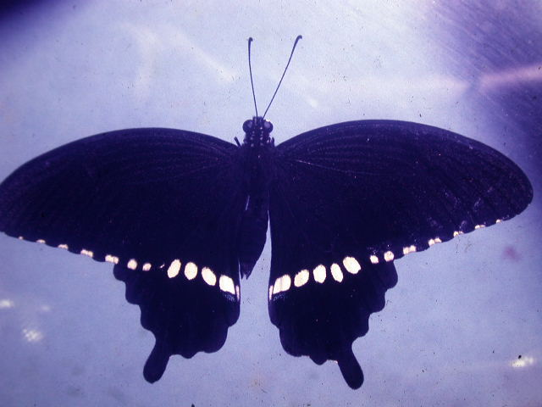
Citrus Swallow Tail

Slide 18
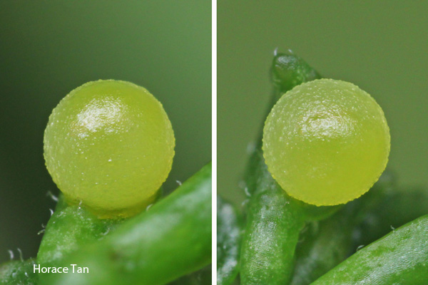
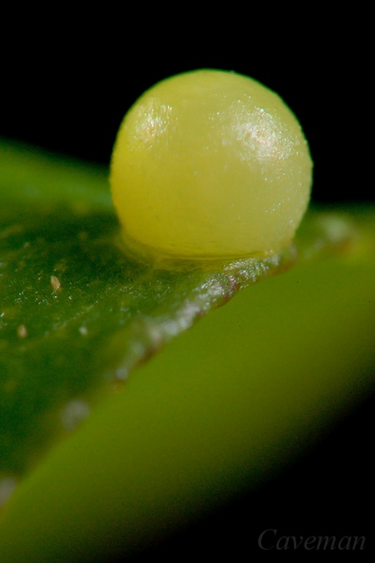

Slide 19
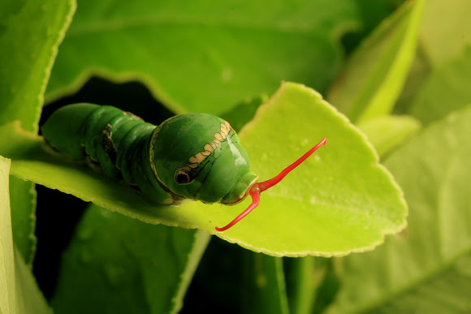
Caterpillar

Slide 20
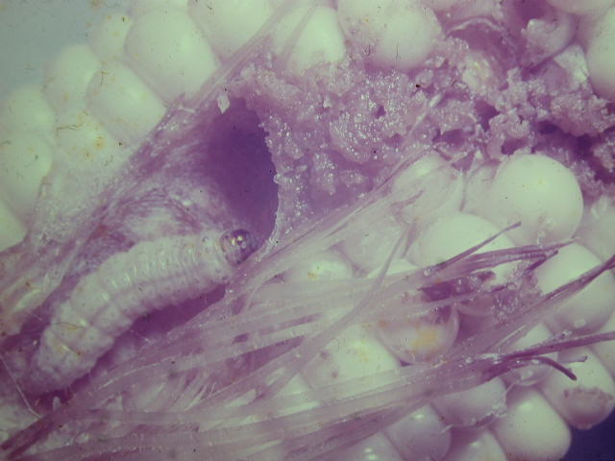
Corn Borer

Slide 21
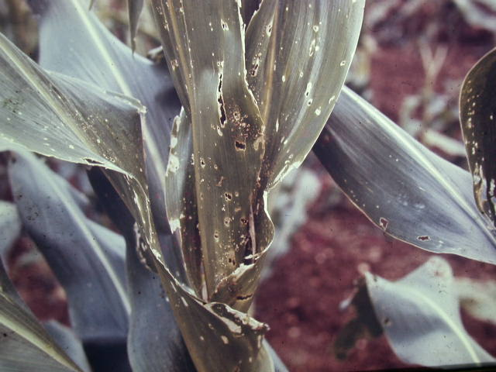
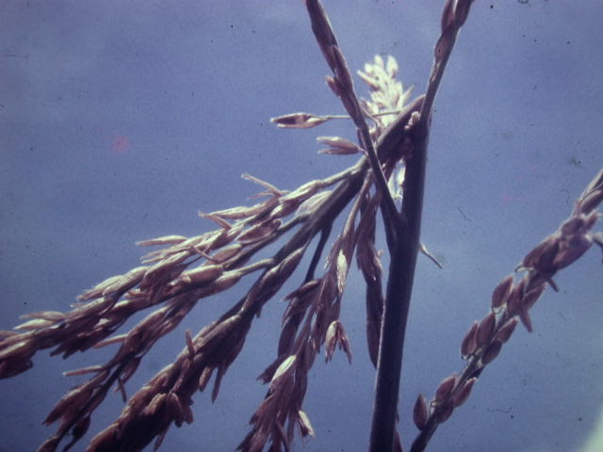
Corn Borer damage

Slide 22
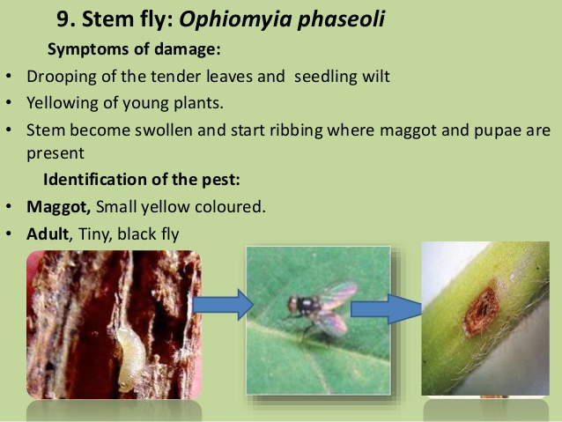

Slide 23
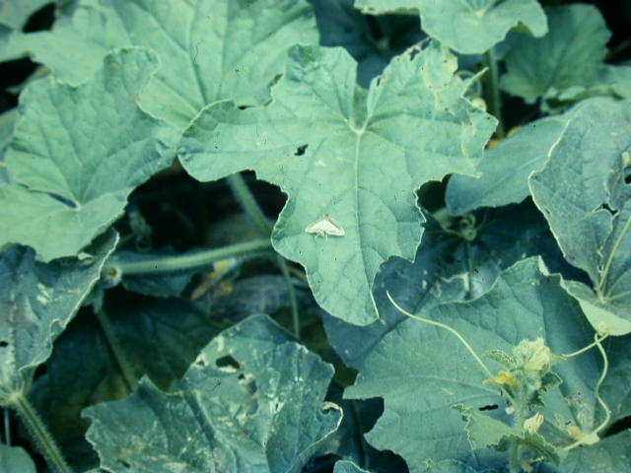
Cucumber Worm Moth

Slide 24
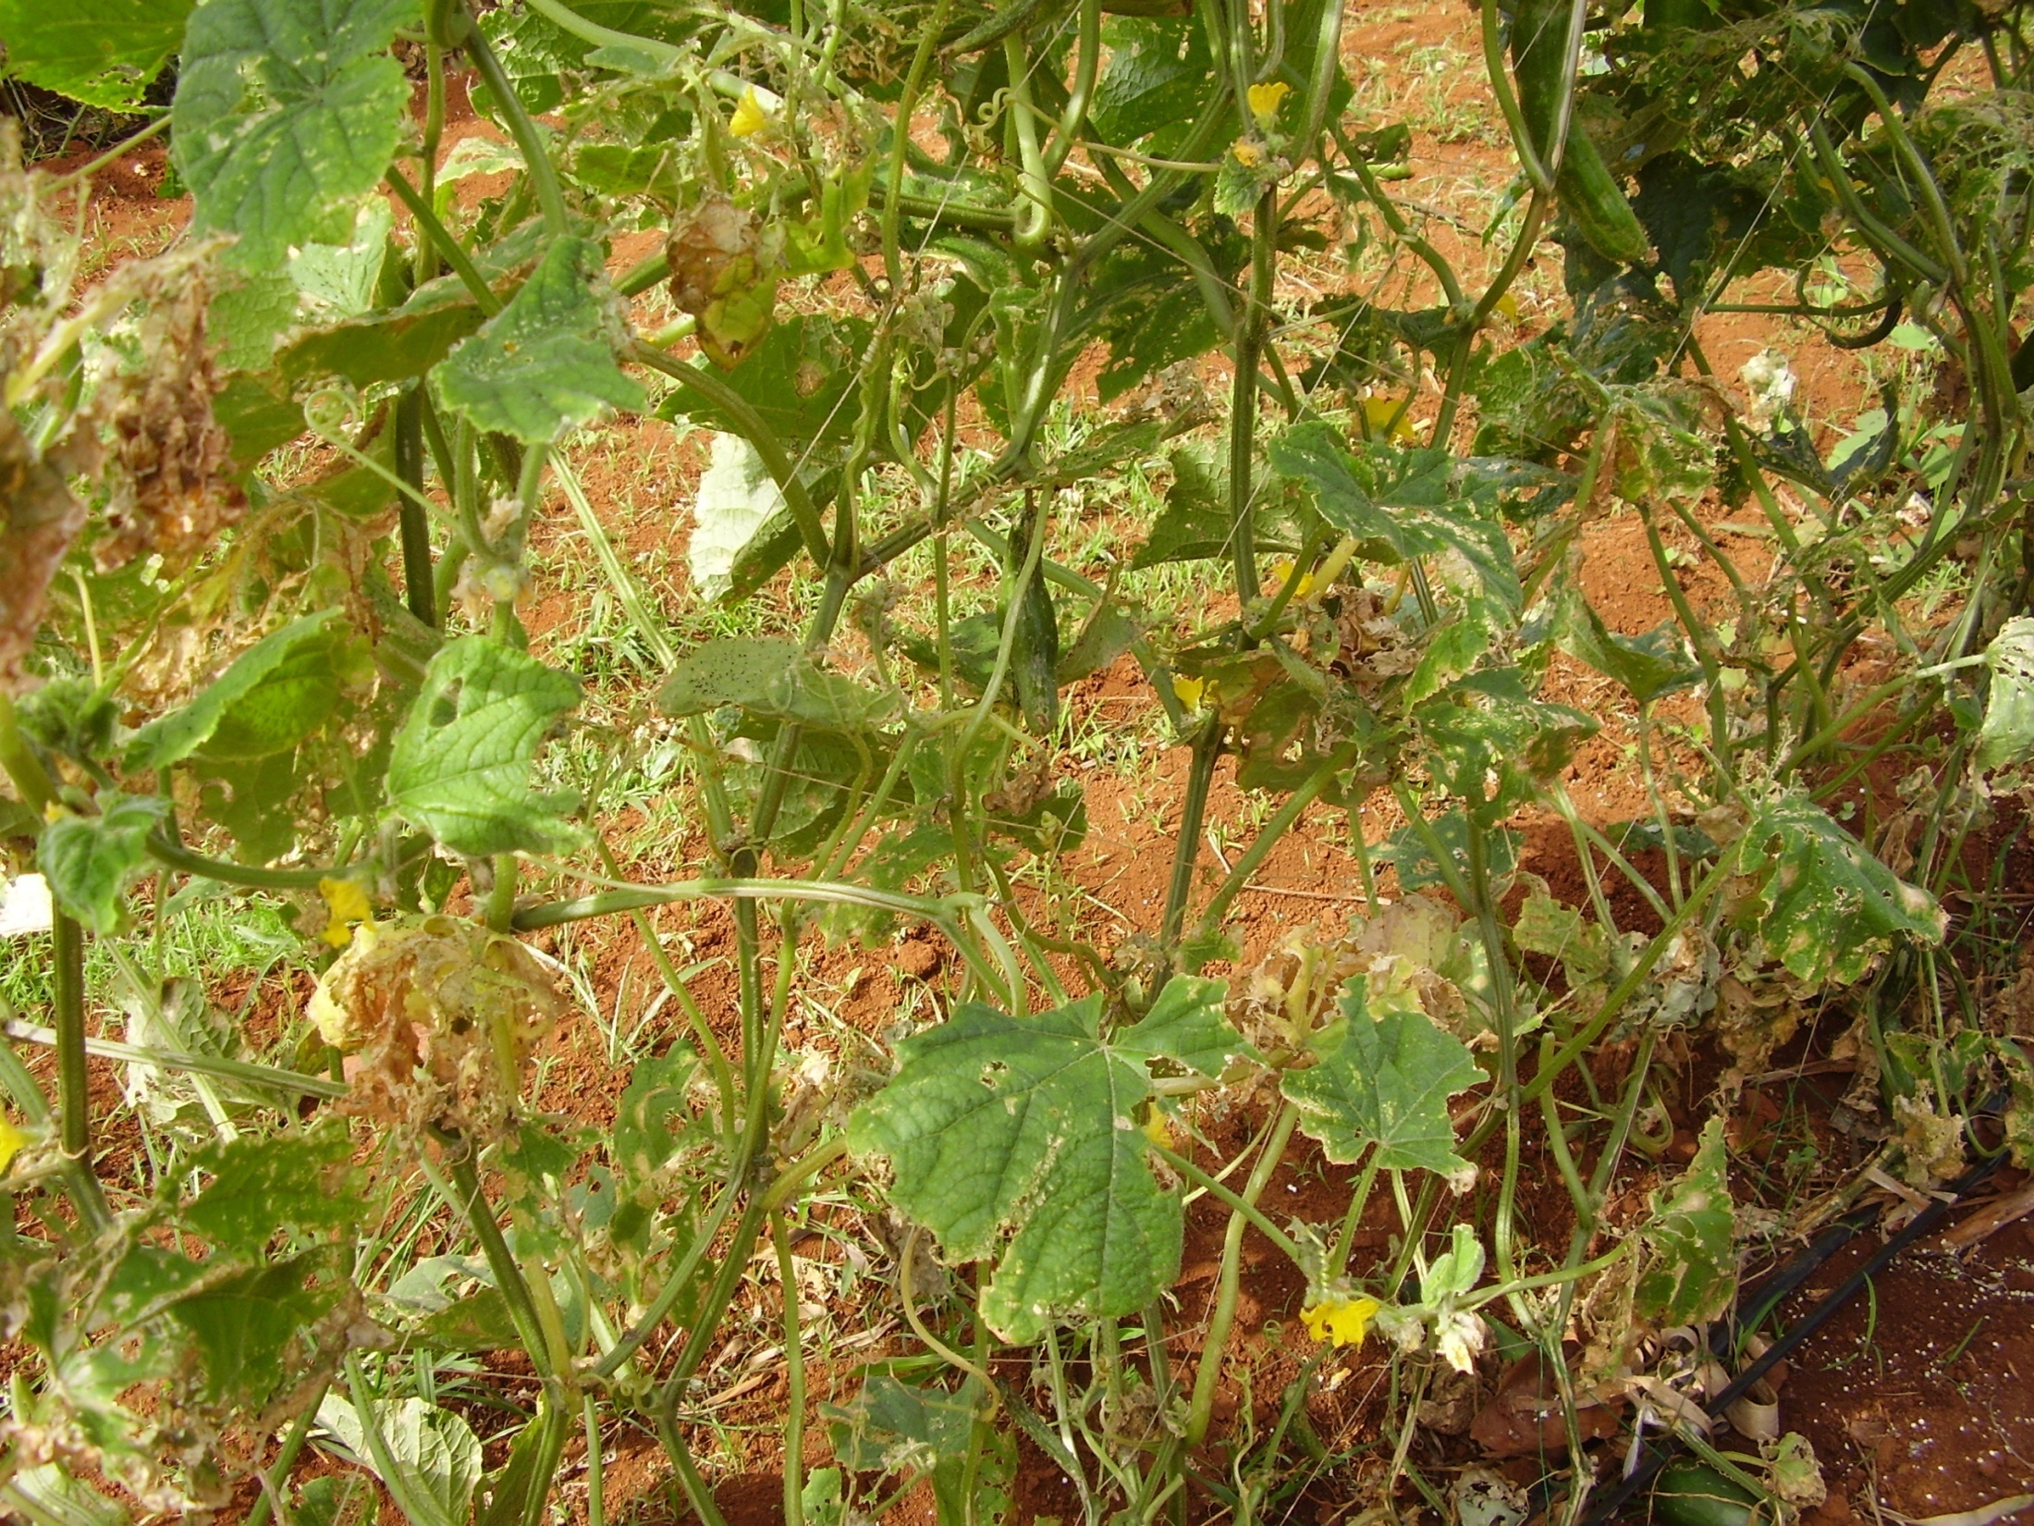

Slide 25
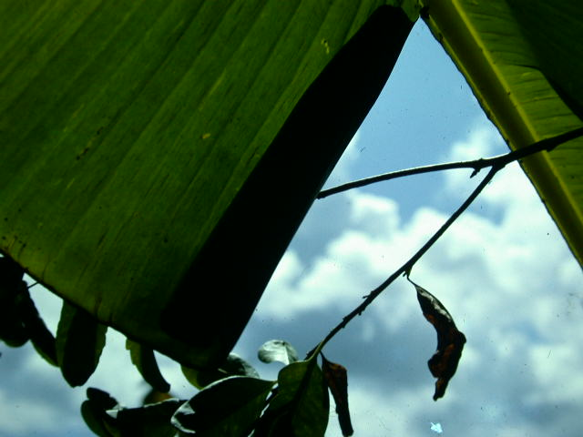
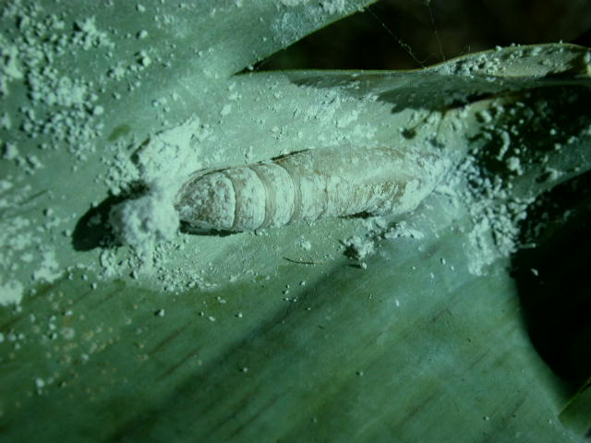
Banana leaf roller damage
Pupa

Slide 26


Slide 27
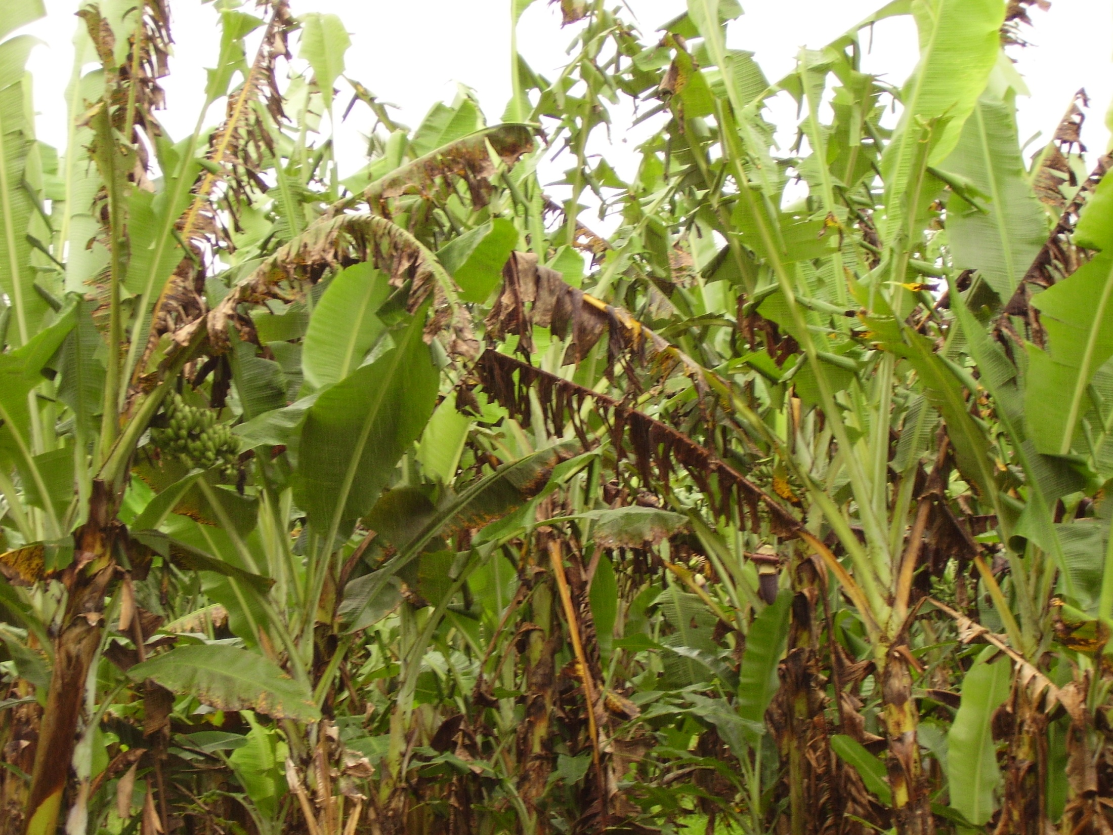

Slide 28
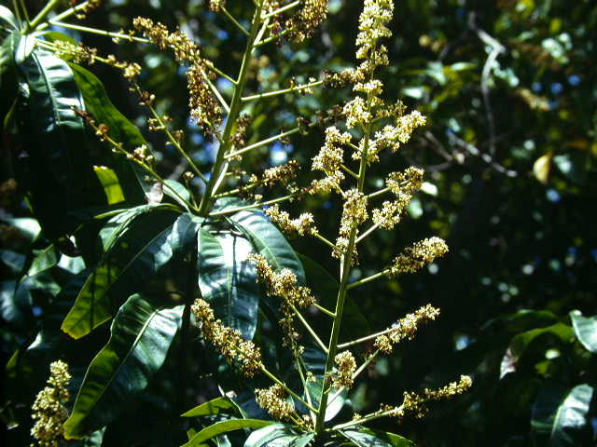
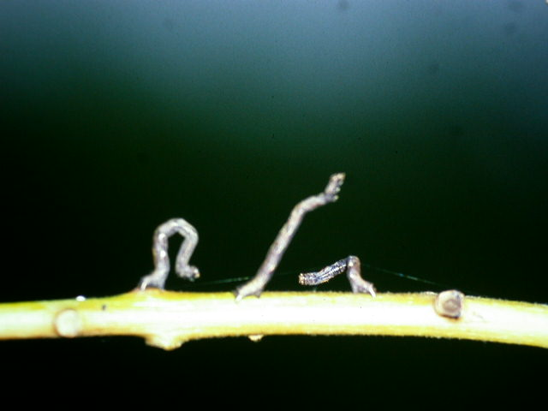
Mango flower
Looper

Slide 29
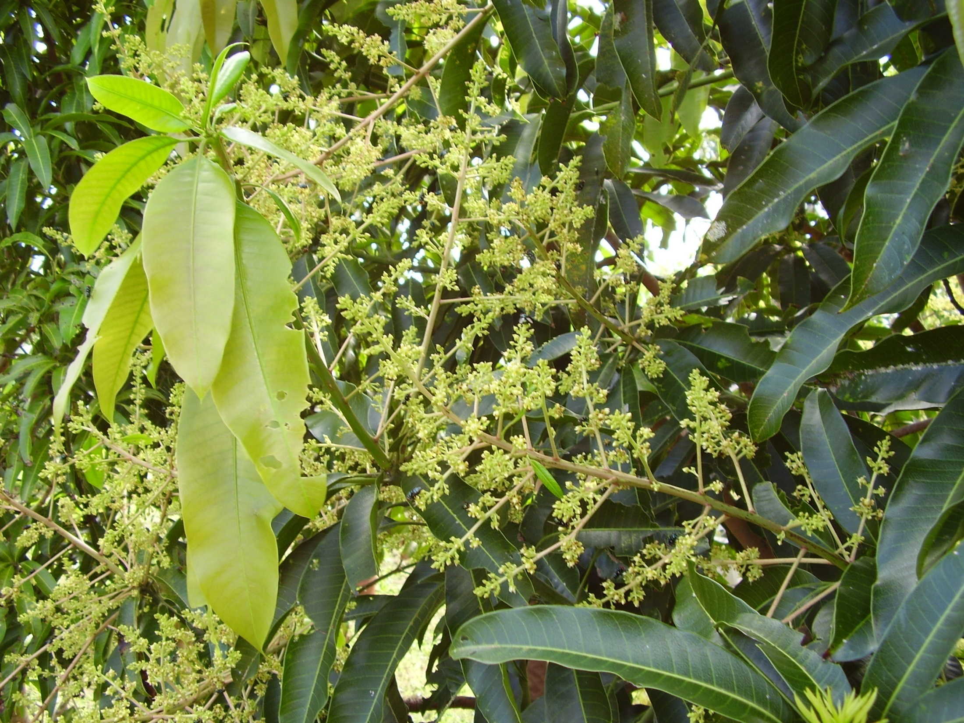

Slide 30
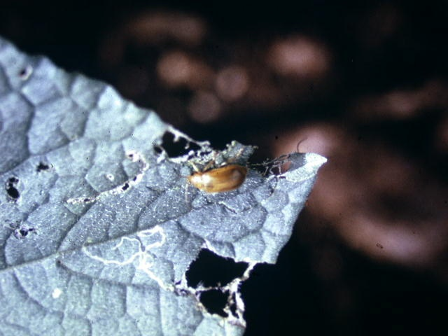
Cucumber Beetle

Slide 31
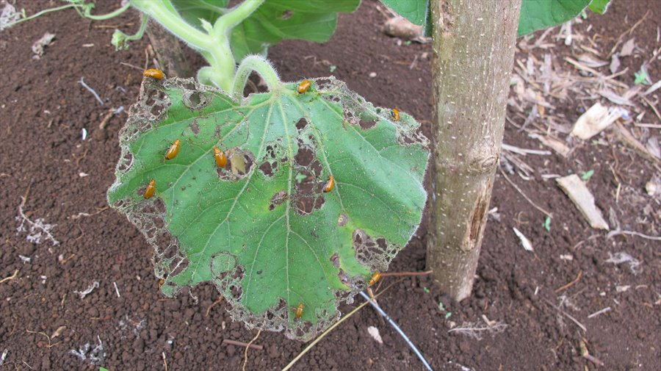

Slide 32
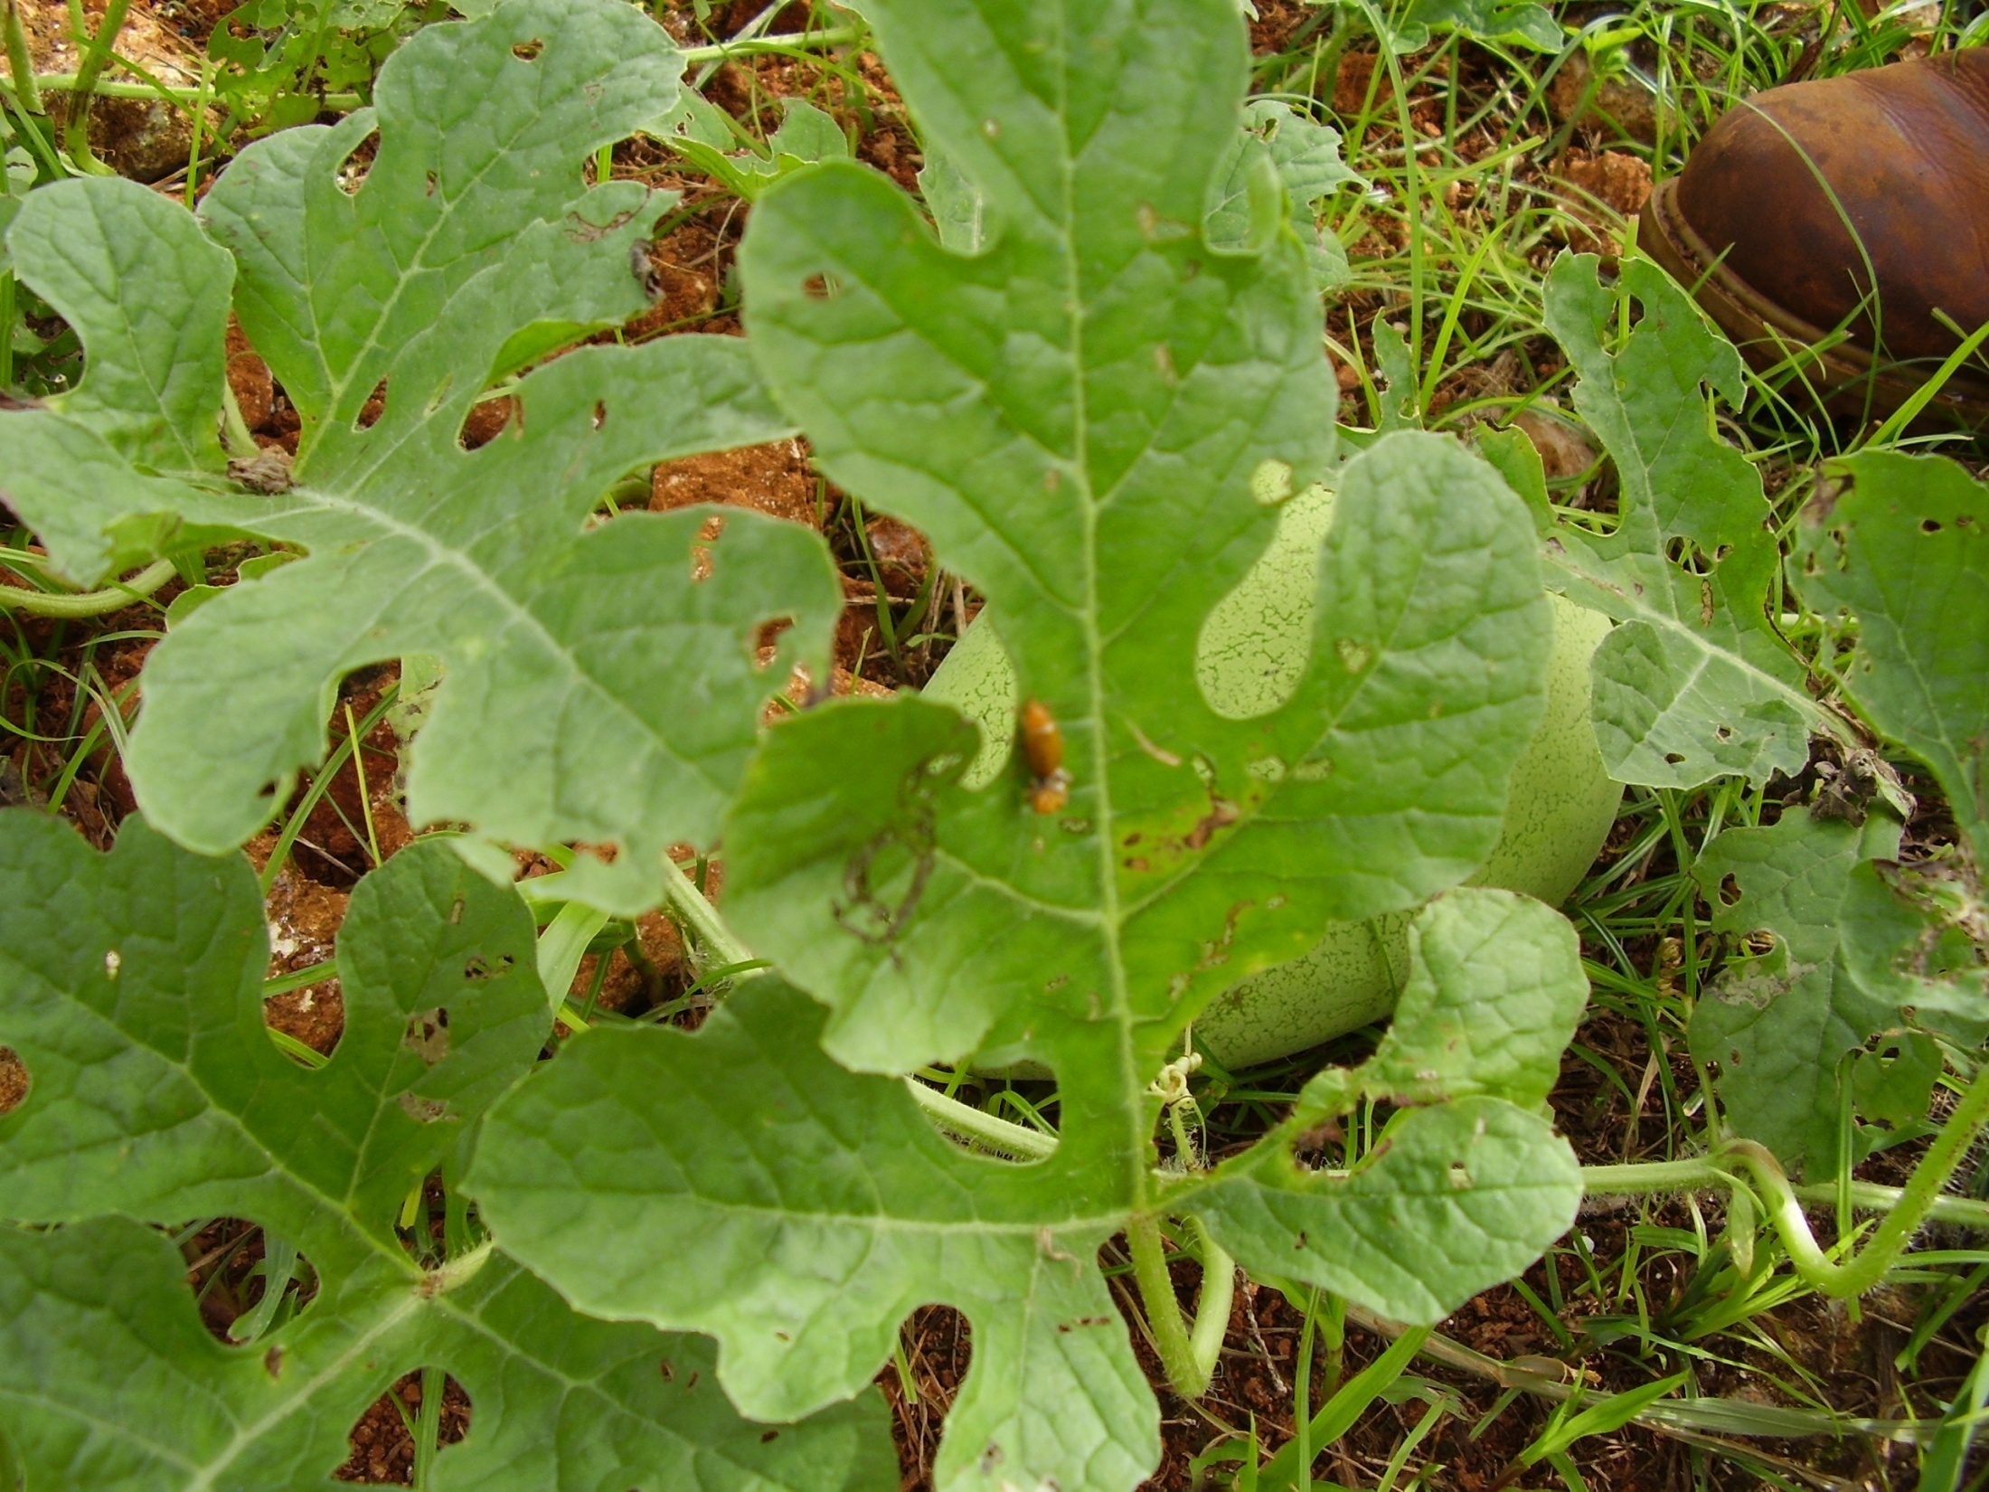

Slide 33
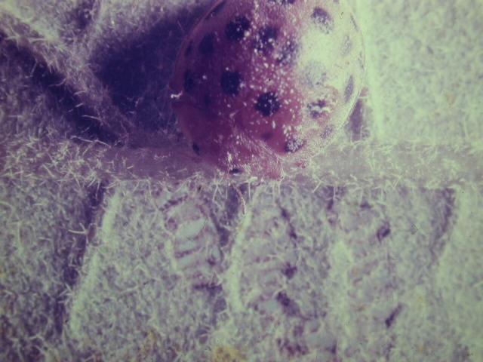
Philippine Lady Beetle

Slide 34
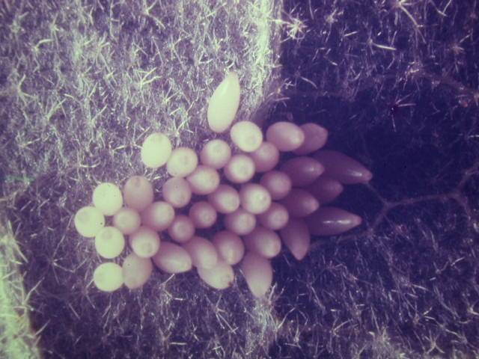
Eggs

Slide 35
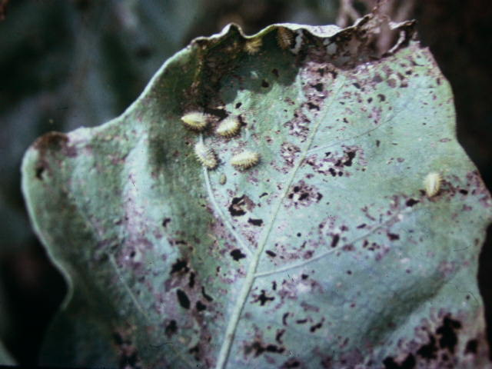
Larvae

Slide 36
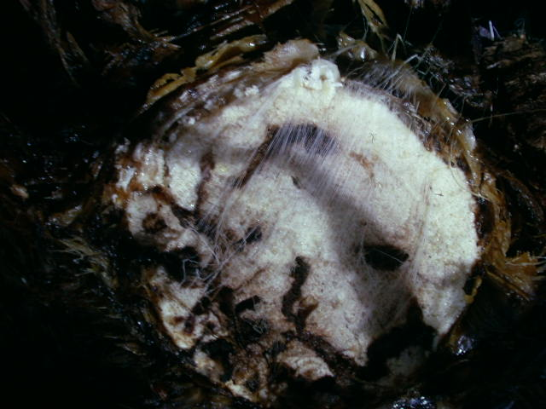
Banana Weevil damage

Slide 37
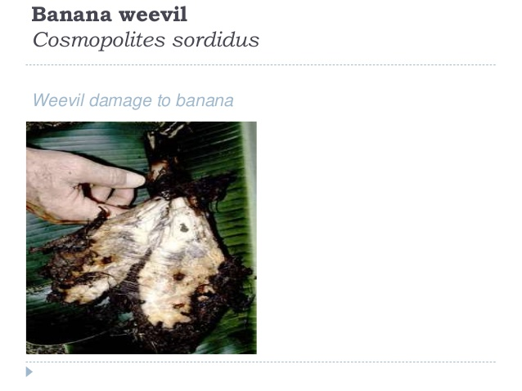

Slide 38
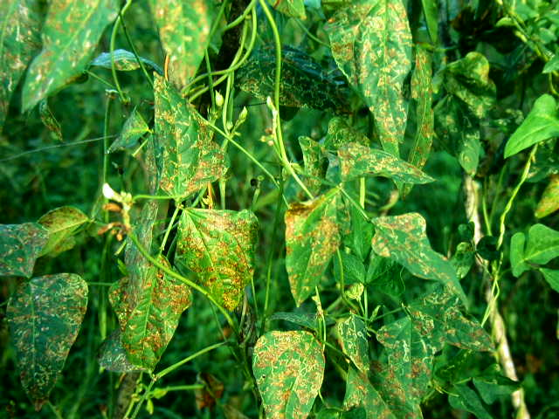
Leafminer damage on beans

Slide 39
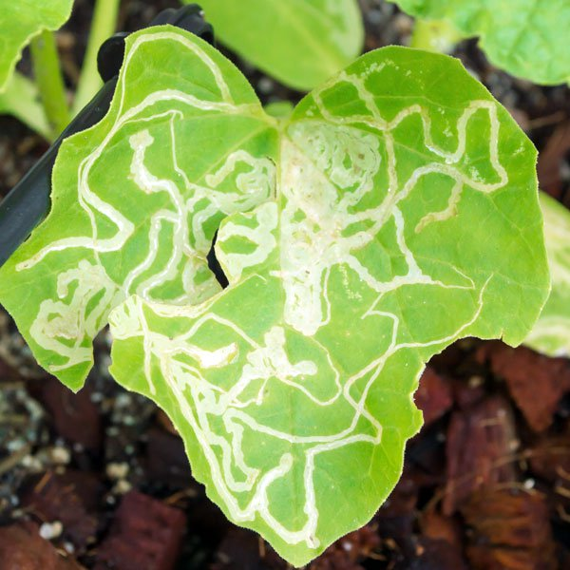

Slide 40
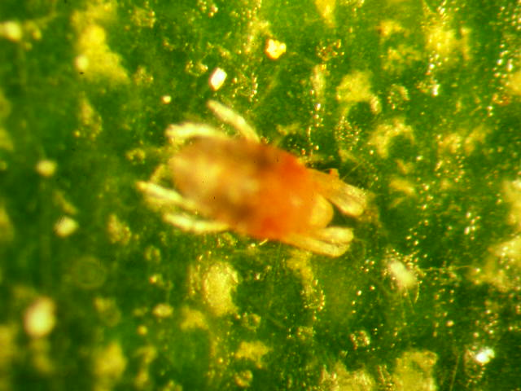
Mite

Slide 41
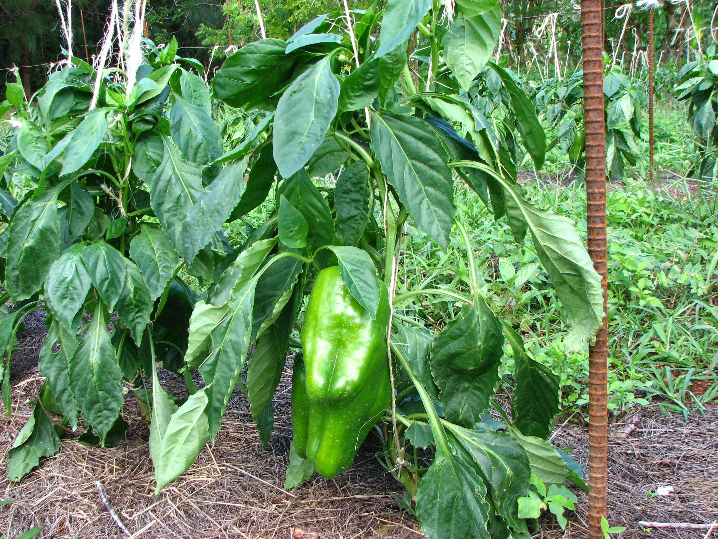
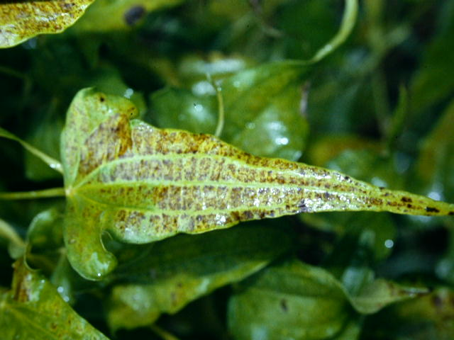
Mite Damage to Yam

Slide 42
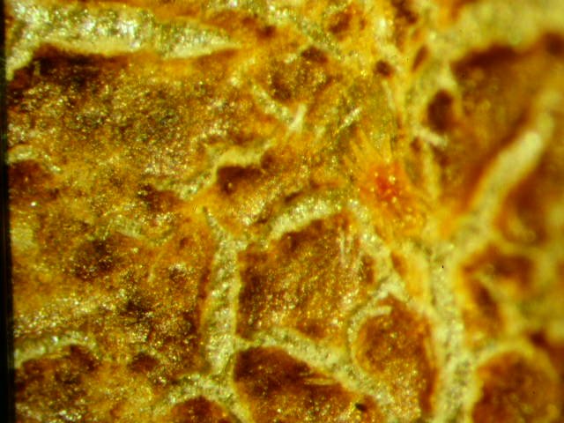
Mite Damage

Slide 43
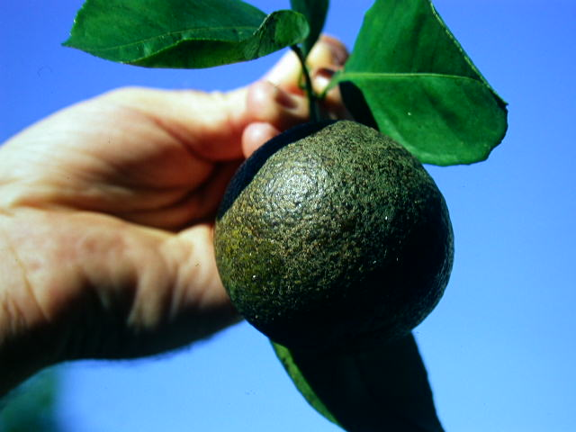
Mite damage to citrus

Slide 44
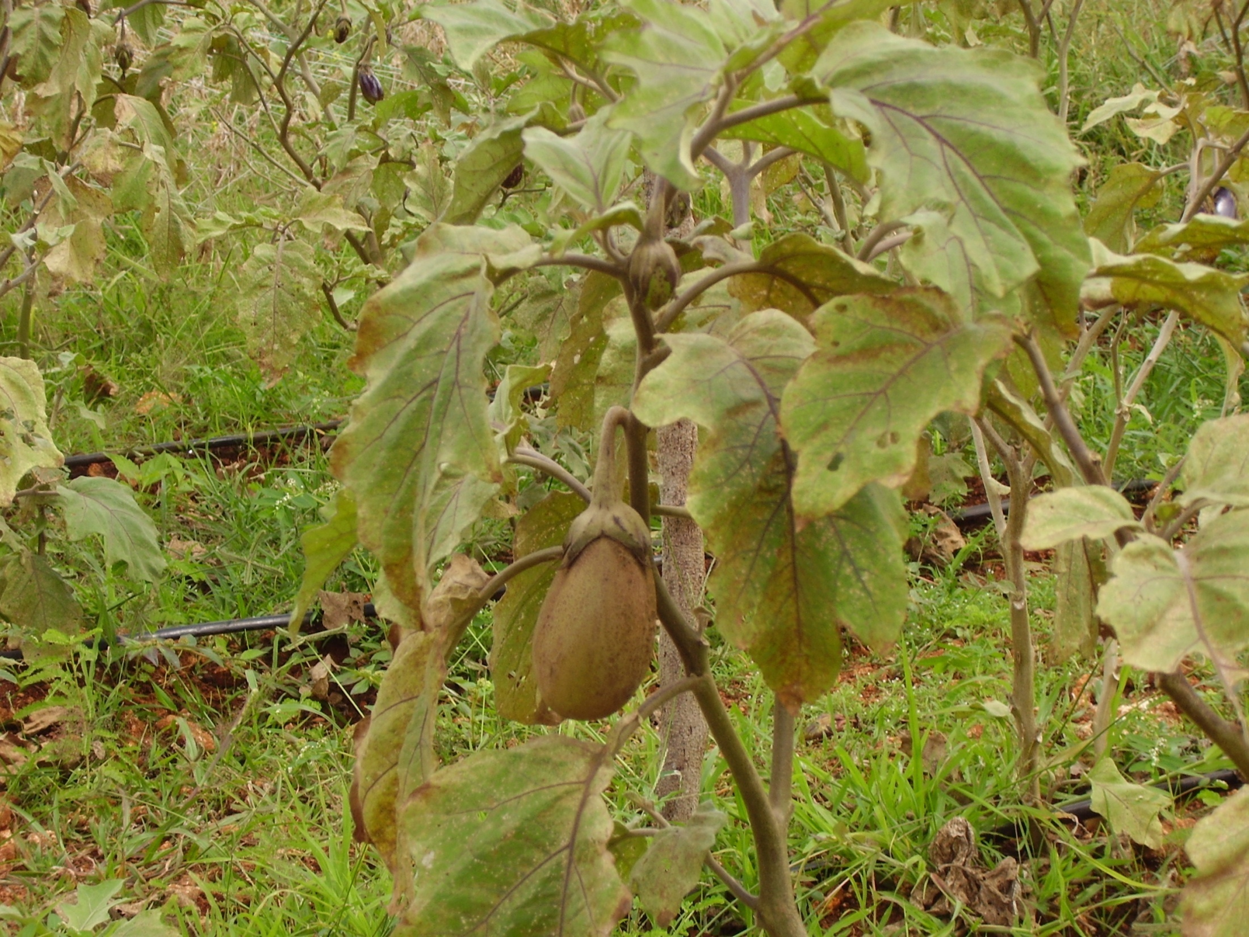

Slide 45
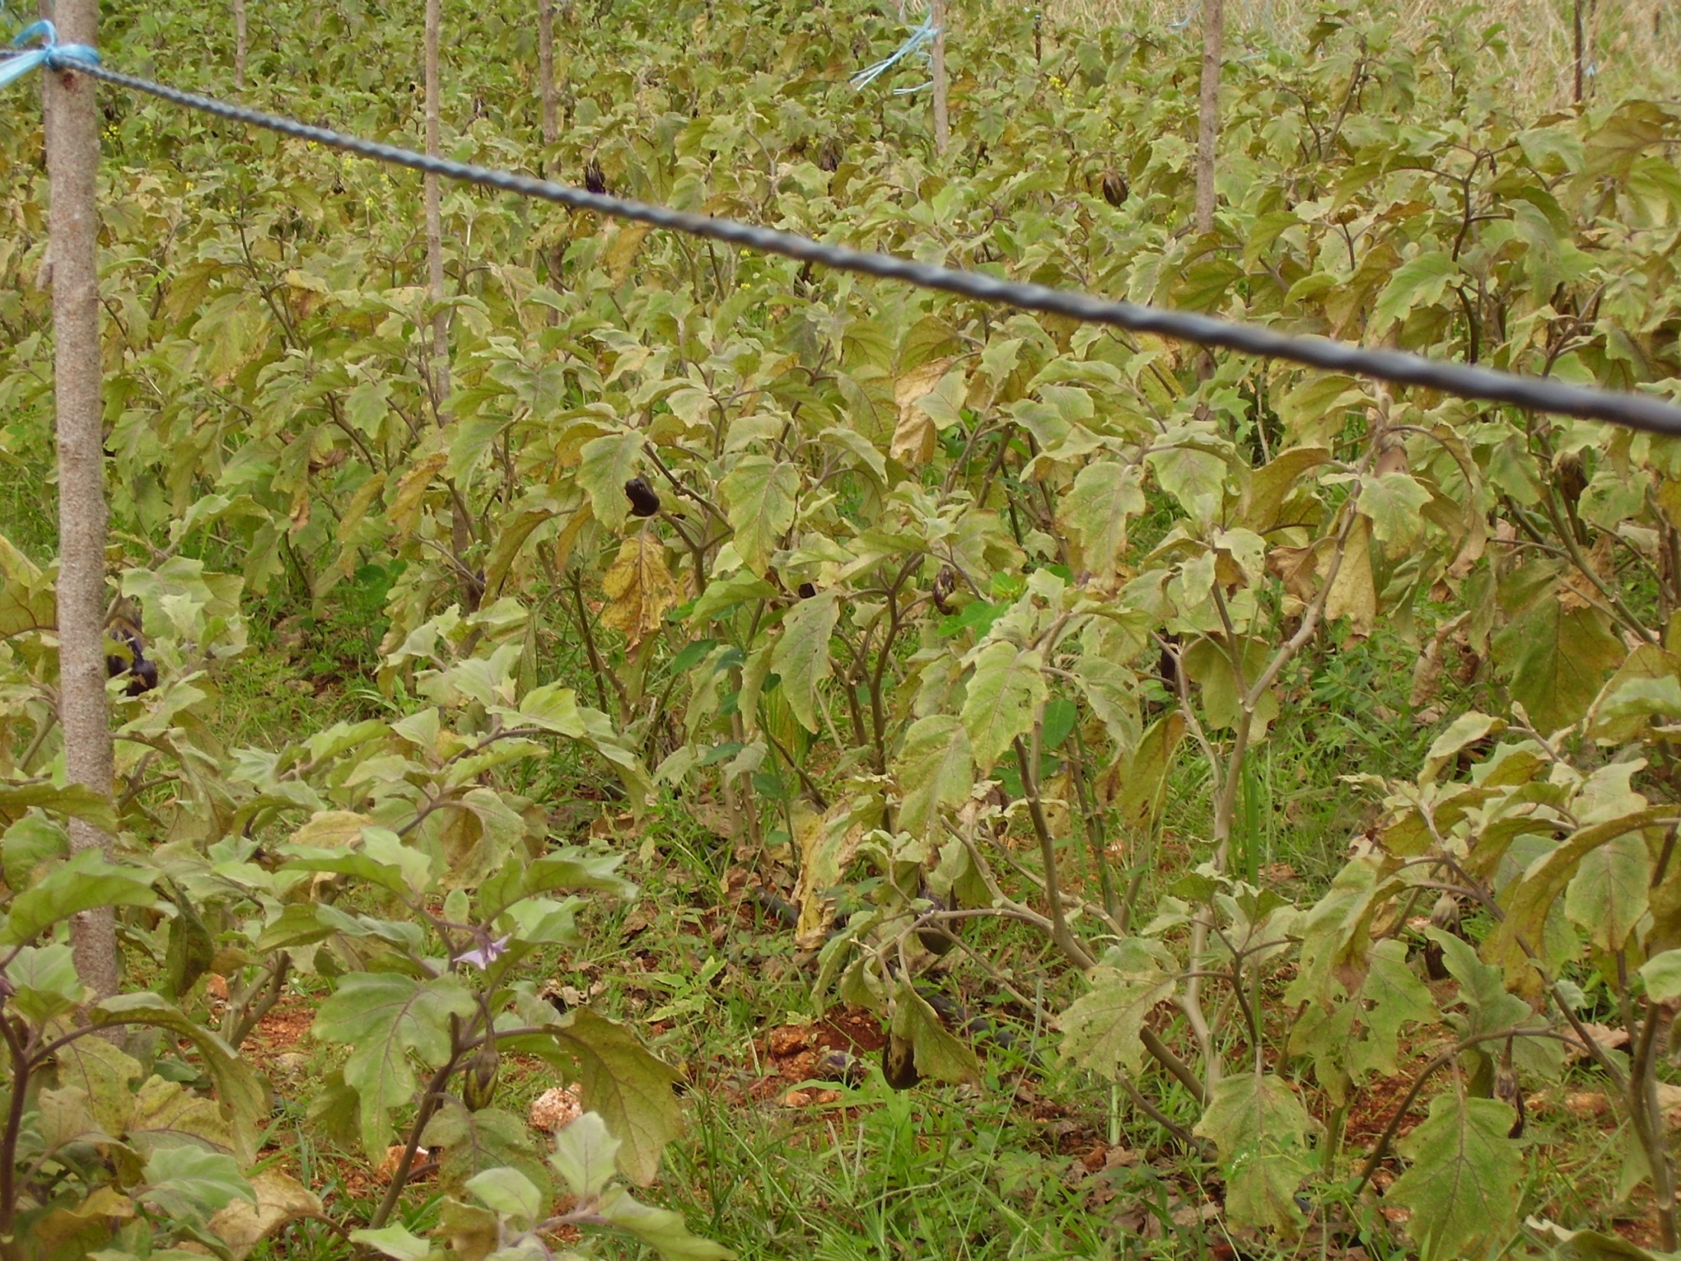

Slide 46
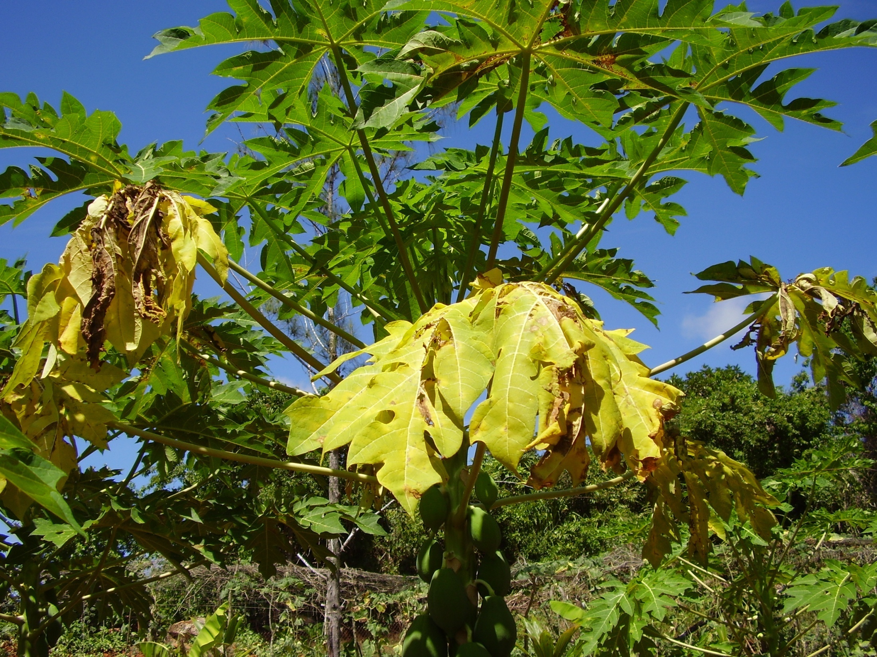

Slide 47
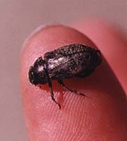
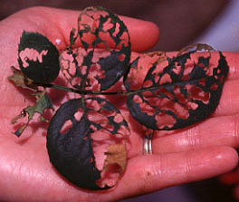
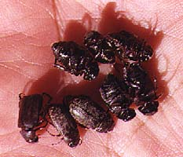
Chinese rose Beetles
250 plants from a wide variety of ornamental and cultivated crops are attacked

Slide 48


Slide 49


Sweet potato bug

Slide 50

Red Banded Thrips

Slide 51


Slide 52

Fruit Piercing Moth Eudocima fullonia

Slide 53

Pacific Fruit-Piercing Moth
(Otheris fullonia)
Adult
West Africa to French Polynesia

Slide 54

Proboscis (of fruit piercing moth)

Slide 55


Slide 56


Slide 57





Slide 58

Euplectrus maternus larva on
E. Fullonia 2nd instar
-Ectoparasitoid
-Brought from India in 1998
-1st,2nd,and 3rd instar larvae

Slide 59

Euplectrus maternus pupae
-5000 parasitoids were released from 1999-2001

Slide 60
Erythrina gall wasp Quadrastichus erythrinae

Slide 61


Flame tree looper

Slide 62


Mud wasp

Slide 63

Palau coconut beetle Introduced to Guam - 1973

Slide 64

Palau coconut beetle and grubs

Slide 65

Leaf damage

Slide 66

Release of the biocontrol agent Tetrastichus brontispae - 1974

Slide 67



Scales
Red Coconut Scale damage Furcaspis oceania

Slide 68

Ulithi - From where the parasitoid was collected Adelencyrtus oceanicus

Slide 69


Red coconut scale with a parasitoid emergence hole
Emergence holes

Slide 70

New Guinea sugarcane weevil & grubs Rhabdoscelis obscurus

Slide 71
New Guinea sugarcane weevil and grubs Rhabdoscelis obscurus
parasitoid Lixophaga sphenophori

Slide 72


Rhabdoscelus obscurus damage on Sago palm

Slide 73

Aceria guerronis, Coconut Mite A Possible Threat to Coconuts in the Pacific

Slide 74
First noticed in Mexico in 1965
Cameroon - 1967
Columbia - 1971
Cuba - 1972
Ivory Coast - 1975
Puerto Rico - 1977
Dominican Republic - 1980
Florida - 1984

Slide 75


Slide 76


Slide 77

In January 2002 our attention was drawn to the Mealybug infestation on papaya

Slide 78
Over 50 different species of plants are affected by this Mealybug.
The most noticeably affected plants on Guam are: Papaya Plumeria Hibiscus

Slide 79


Slide 80

Severely affected older leaves turn yellow and dry up and fall.

Slide 81

Heavy infestations of the PM on papaya occur along the veins and the midribs of the older leaves and all areas of the tender leaves and fruits.

Slide 82

The tender leaves become crinkly, yellow and the terminal shoots become bunchy and distorted.

Slide 83
On Guam plumeria trees seemed to have the heaviest PM infestations.

Slide 84


Slide 85


Slide 86

Heavy mealybug populations produce large volume of honey dew, which causes black sooty mold that cover the infected fruits and vegetation on all infested plant species.

Slide 87
Release of Biocontrol
Three species of parasitoids (A. loecki, A. papayae and P. mexicana) were shipped to Guam from Puerto Rico.
They were released at different study sites around the island in June 27, 2002.
Typhoon ‘Chataan’ on July 6, 2002

Slide 89


Oriental fruit fly damage to mango
Maggots in the pulp

Slide 90
Oriental fruit fly was eradicated in the Marianas in the early 1970s using male annihilation technique. Recently this fruit fly has established in Palau.

Slide 91

Accurate identification is the first step in an effective pest management program.
Know your crops
Notes:
You need to know the physical features of the pests likely to be encountered, characteristics of the damage they cause, their development and biology, whether they are continuous, sporadic or potential pests, and what your control goal is.

Slide 92


Slide 93


Slide 94


Slide 95


Slide 96


Slide 97


Slide 98


Slide 99


Slide 100

Pest Monitoring
What kind of pest are present
Are the numbers great enough to warrant control?
When is the right time to begin control?
Have the control efforts successfully reduced the number of pests?

